Slide 1
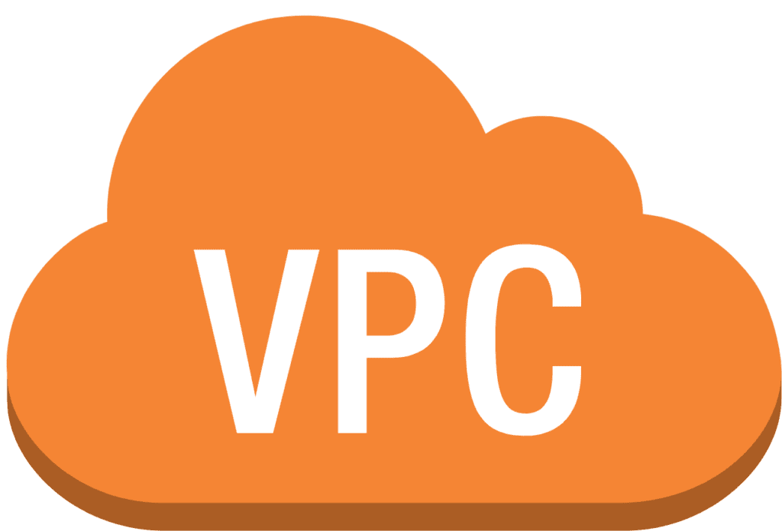

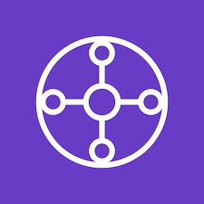
VPC Endpoints and Transit Gateway
Secure and Scalable Networking in AWS
Presented by: Syed Mubeen

Slide 2
Agenda
VPC Endpoints
-What is a VPC Endpoint?
-Types of VPC Endpoints.
-Benefits and Use Cases
Transit Gateway (TGW)
-What is a Transit Gateway?
-TGW Architecture
-TGW vs VPC Peering
-Benefits of Transit Gateway
-Use Cases of TGW
-TGW Pricing

Slide 3
VPC ENDPOINT

Slide 4
What is a VPC Endpoint?
Definition:
A VPC Endpoint allows private, secure communication between your Virtual Private Cloud (VPC) and AWS services without traversing the public internet.
Key Features:
Improves security by avoiding public internet exposure.
Traffic stays within the AWS network.
Reduces the need for an internet gateway or NAT devices.

Slide 5
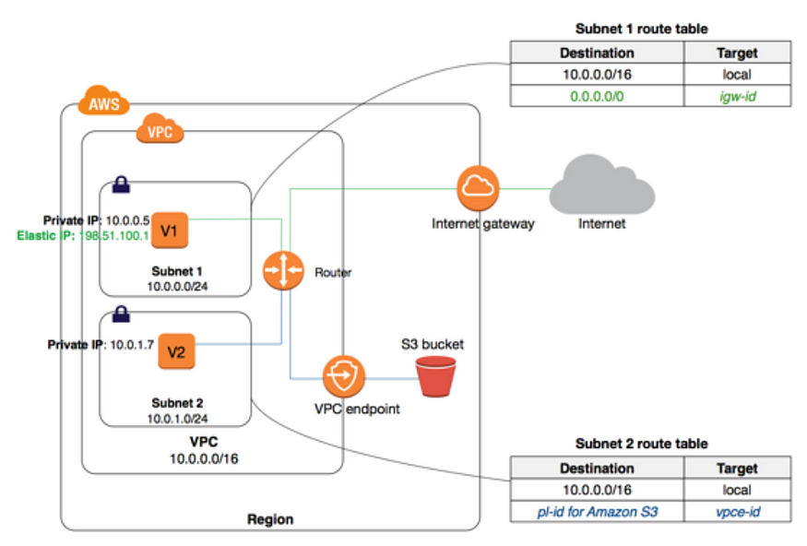
Architecture

Slide 6
Types of VPC Endpoints
Interface Endpoints:
Uses AWS PrivateLink to connect to AWS services privately over a secure network interface.
Typically used for services like EC2, Lambda, and Kinesis.
Gateway Endpoints:
Directly connects to S3 and DynamoDB.
No need for an internet gateway or NAT.

Slide 7
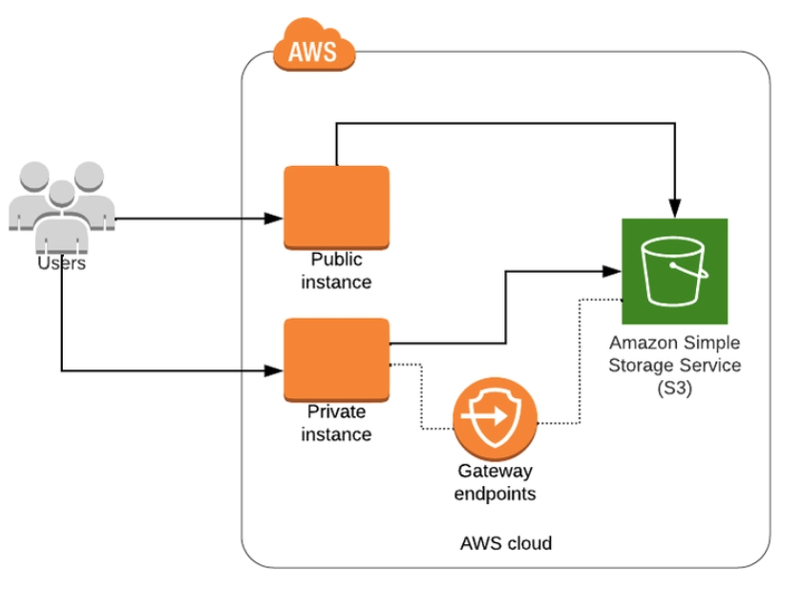
Gateway Endpoint
Gateway endpoint - A gateway Endpoint is a gateway that you specify as a target for a route in your route table for traffic destined to a supported AWS service.

Slide 8
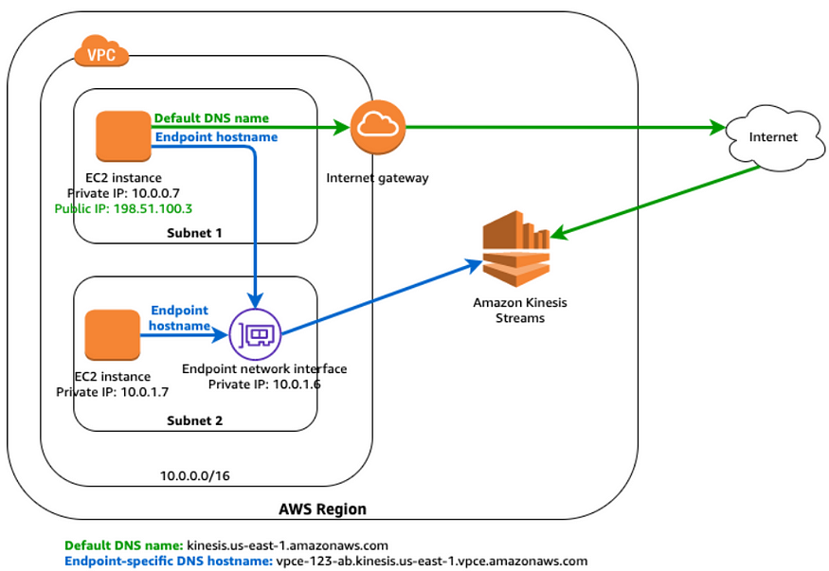
Interface Endpoint
Interface endpoint - An Interface Endpoint is an elastic network interface with a private IP address from the IP address range of your subnet that serves as an entry point for traffic destined to a supported service.

Slide 9
Benefits and Use Cases of VPC Endpoints
Benefits:
Enhanced Security: No exposure to the public internet.
Cost Reduction: Lower data transfer costs compared to going through the internet.
Performance: Faster and more reliable connections to AWS services
Use Cases:
Connecting to services like S3, DynamoDB, or other private services.
Allowing isolated workloads to access AWS services without internet access.

Slide 10
Transit Gateway (TGW)

Slide 11
What is a Transit Gateway (TGW)?
Definition:
A Transit Gateway is a fully managed service that acts as a central hub for connecting multiple VPCs,
VPNs, and on-premises networks.
Key Features:
Simplifies VPC-to-VPC communication.
Allows connections to on-premises networks, AWS Direct Connect, or VPNs.
Scales automatically to support thousands of VPCs.
Comparison:
Compare Transit Gateway with VPC Peering (TGW simplifies management by reducing the number of
connections).

Slide 12
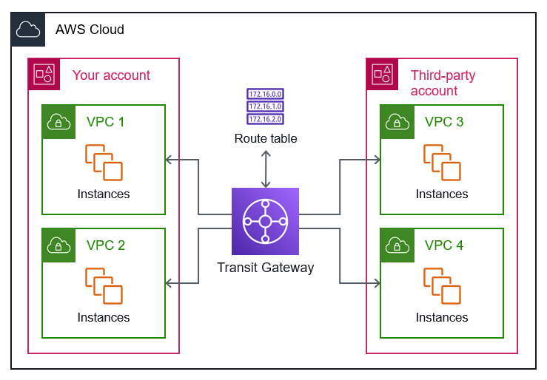
Transit Gateway Architecture

Slide 13
Transit Gateway Architecture
Hub-and-Spoke Model:
VPCs connect to TGW like spokes on a wheel.
Centralized routing through the TGW makes it easy to manage traffic.
Traffic Flow:
All traffic from one VPC to another flows through the TGW.
Secure, efficient communication between multiple VPCs and on-premises resources.

Slide 14
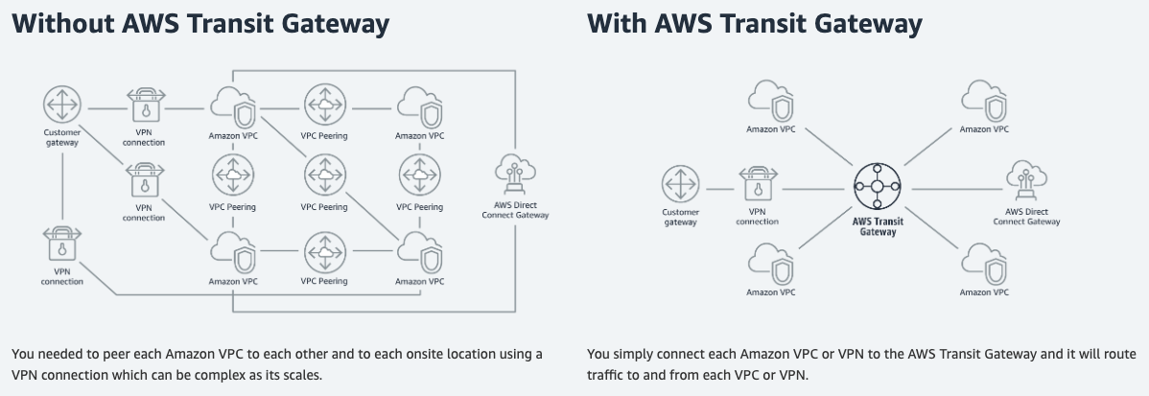
Transit Gateway vs vpc peering

Slide 15
Benefits of Transit Gateway
Centralized Routing: Simplifies network architecture by reducing the need for VPC peering.
Scalability: Easily supports thousands of VPCs, regions, and hybrid architectures.
High Availability: Fully managed service with built-in redundancy and availability.
Security: Centralized control over routing and network traffic, reducing potential attack surfaces.

Slide 16
Use Cases for Transit Gateway
Connecting Multiple VPCs: Easily connect large-scale VPC networks across regions.
Hybrid Cloud: Connect on-premises networks and AWS environments with Direct Connect or VPNs.
Shared Services: Use TGW to manage centralized access to shared services, such as DNS, logging,
or databases.

Slide 17
Transit Gateway Pricing
Pricing Components:
Attachment Costs: Per-hour costs for each VPC or resource attached to the TGW.
Data Transfer Costs: Costs for data transferred between VPCs and TGW.
Considerations:
Pricing can vary based on data transfer and regions, so understanding your traffic
pattern is important for cost management.

Slide 18
Conclusion
VPC Endpoints provide private, secure, and cost-efficient access to AWS services, improving security
and network performance.
Transit Gateway simplifies network management by centralizing routing for multiple VPCs and on-premises networks, providing scalability and flexibility.

Slide 19
Thank you

